Slide 1
Probability of Categorical Variables and Solutions

Slide 2
1 Probability
Probability: Likelihood/chance that a particular incident will occur
0-1.0 or 0-100%

Slide 3
Experiment: observation which has two or more possible outcomes
Outcome: a particular results of an experiment
e.g. Taking an exam--- pass or fail
Being pregnant --- having a baby boy

Slide 4
Sample space: collection of all outcomes
e.g. all examination results
Event: a specific collection of outcome
e.g. all the students who have passed

Slide 5
2. Probability Distribution
Binomial probability distribution
a) Event present only two outcomes
b) Two outcomes are mutually exclusive
c) Each trial is independent
d) Probability of getting outcome A on each trial is the same from trial to trial

Slide 6
e.g. Obtaining H or T for two trials in tossing a coin
First toss Second toss
H H
H T
T H
T T

Slide 7
# of T P(x)
0 1/4=0.25
1 2/4=0.50
2 1/4=0.25

Slide 8
e.g. Tossing a coin 3 times
Probability of getting all three Hs?
Probability of getting H at each trial=1/2

Slide 9
Multiplication Rule
P(H1)xP(H2)xP(H3)=(1/2)x(1/2)x(1/2)=1/8
Probability of getting 3 Hs is 0.125

Slide 10
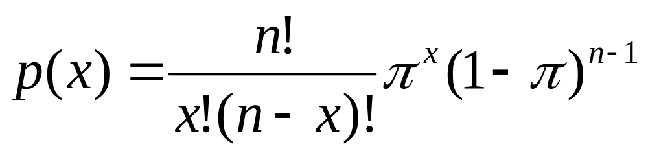
3. Binomial Formula

Slide 11
n: Total number of trials
Pi: Probability of a certain outcome on each trial
X: Number of observed success
e.g. Getting 2 Hs out of 3 trials

Slide 12
Exercise
For families with 5 children,
What is the probability of having 3 girls?
What is the probability that all the children are girls?
What is the probability that at least one child is a girl?

Slide 13
For the previous questions, you can use the binomial distribution table.

Slide 14
4. Solutions for Categorical Variables
Binomial Logistic Regression:
DV is dichotomous variable
IVs are Ratio variables
Nominal or Ordinal variables can be IV
e.g. Probability to vote for Democrat vs. Republican

Slide 15
Multinomial Logistic Regression:
DV is Ordinal variable (with three or more categories)
IVs are Ratio variables
Nominal and Ordinal variables
e.g. Patient’s condition after surgery
(Complication, Fair, Excellent)

Slide 16
5. Poisson Probability Distribution
a) Chance of having a certain outcome in a fixed interval of time (e.g. wars, flu epidemic)
b) Chance of having a certain outcome in a fixed area (e.g. # of accidents in certain intersections)

Slide 17
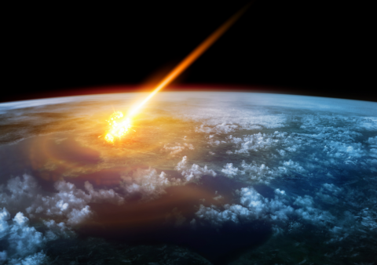
Illustration of an asteroid striking Earth, setting off the K-T mass extinction event. (Credit iStock)

Slide 18
Log-linear Model: No dependent variable
Nominal and/or ordinal variables
e.g. Marital preference
Logit Model: DV is nominal or ordinal
IVs are also nominal or ordinal
plus Ratio covariate
e.g. Occupational mobility

Slide 19

Questions! (looks like Anju who is gone)

